Slide 1
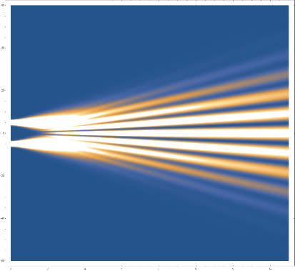
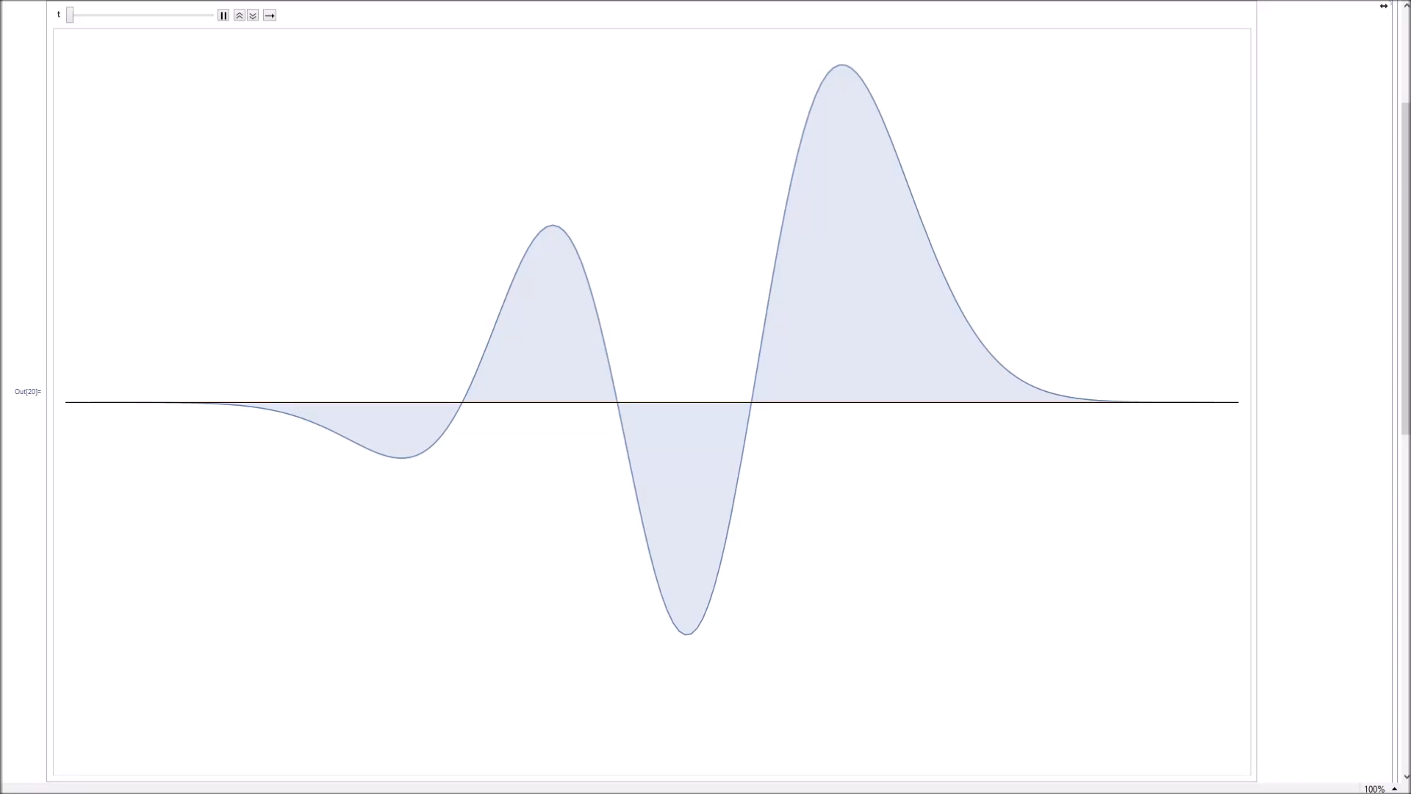
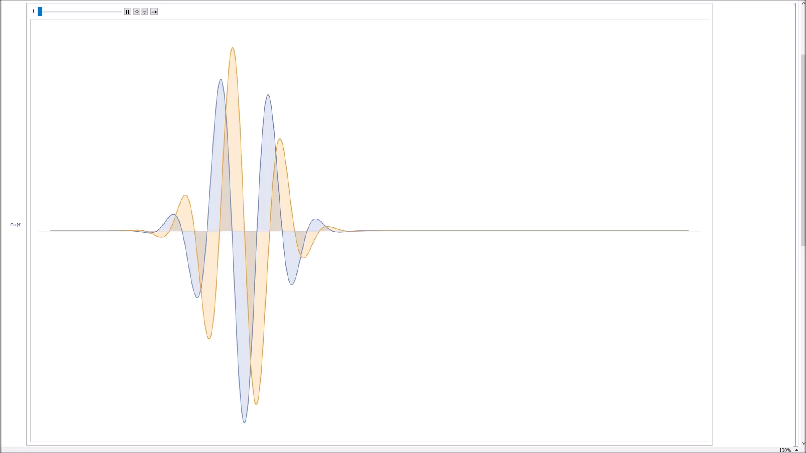
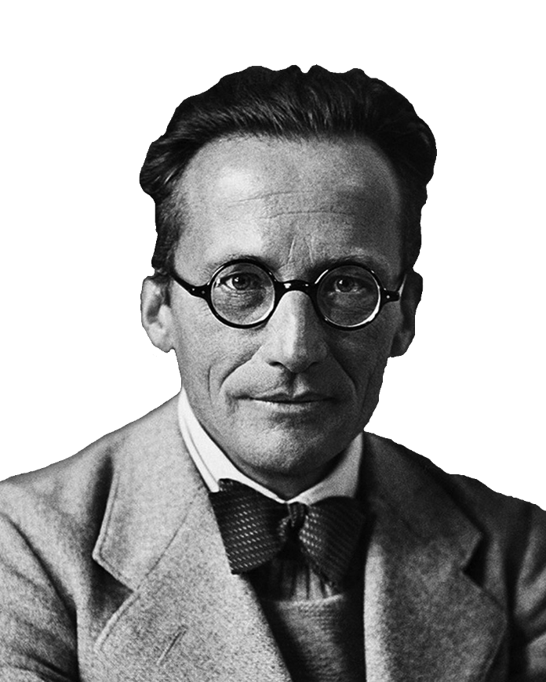
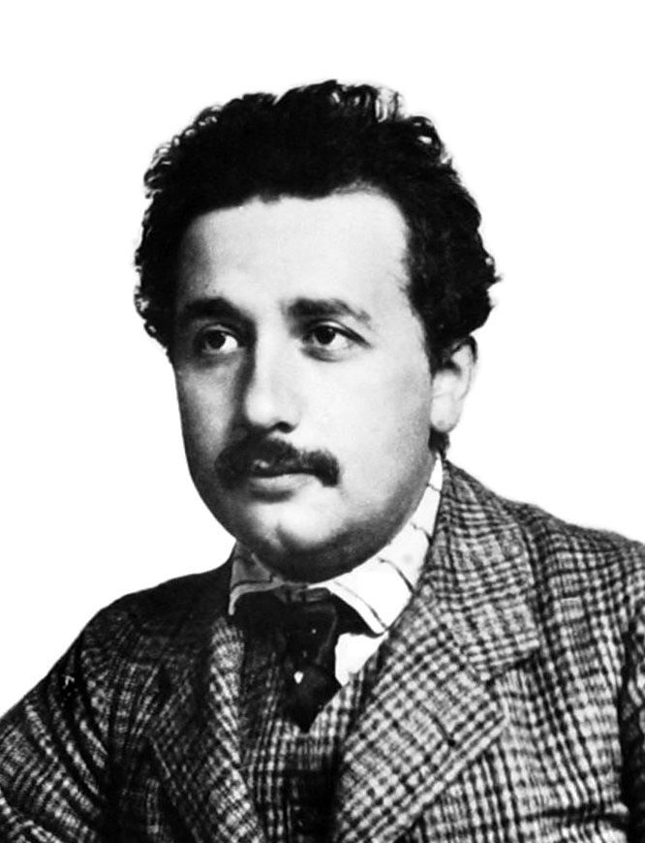
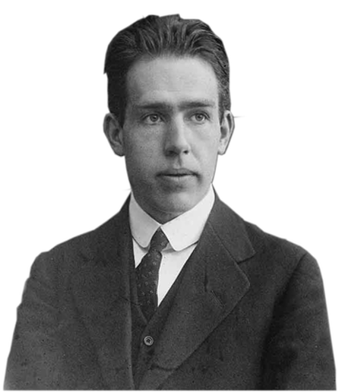
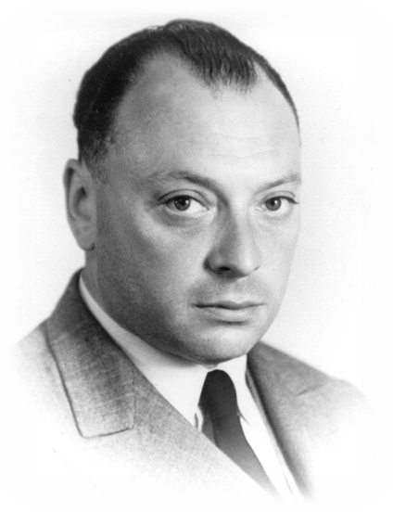
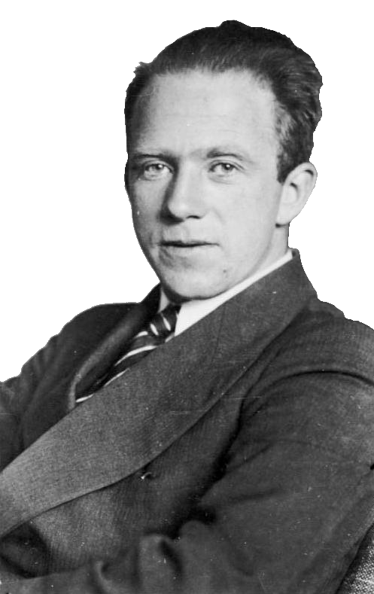

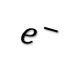
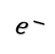
What is Quantum
Mechanics?
$$e^{−}$$
$$e^{−}$$
$$iℏ∂_{t}ψ=ℋψ$$
Tom Dodd

Slide 2
Topics to Cover…
Schrödinger
Equation
Structure of
the Atom
Quantum Spin
Entanglement
Double Slit
Experiment
Uncertainty
Principle
Exclusion
Principle

Slide 3
Quantum Spin

